Slide 1
Text mining of US Consumer Financial Complaints
Springboard – Foundations of Data Science
By
Annapoorani Chockalingam

Slide 2
Problem Statement
CFBP is an government agency helps consumers complaints heard by financial companies.
To study and identify the inappropriate practices and allowing the government to stop those before it becomes a major issues.
Focuses on the analysis of the complaints over different segments, also providing sentiment analysis of the complaints.

Slide 3
Data Extraction
Data - https://www.kaggle.com/cfpb/us-consumer-finance-complaints
18 Variables
Initial Data Cleanups
- Date format conversions
- Factor Conversions
- na.omit
Notes:
Use multiple points, if necessary.

Slide 4
Exploratory Data Analysis
Helps to unfold several facts
No of Complaints – Products, Companies, Issues and Sub Issues
Complaints origination geographically
Notes:
Use brief bullets and discuss details verbally.

Slide 5
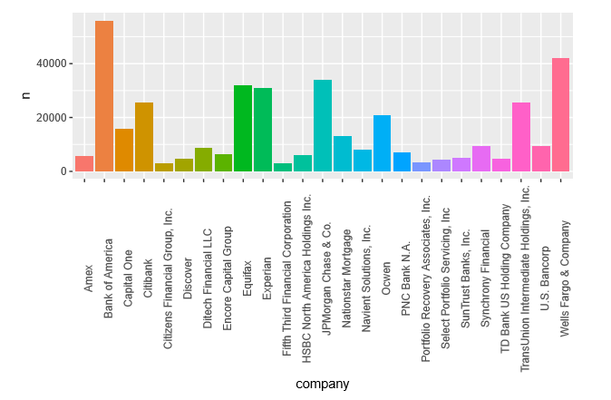
EDA Complaints based on Companies
Companies like Bank of America, Wells Fargo, TU, Equifax and Experian received more no of complaints.

Slide 6
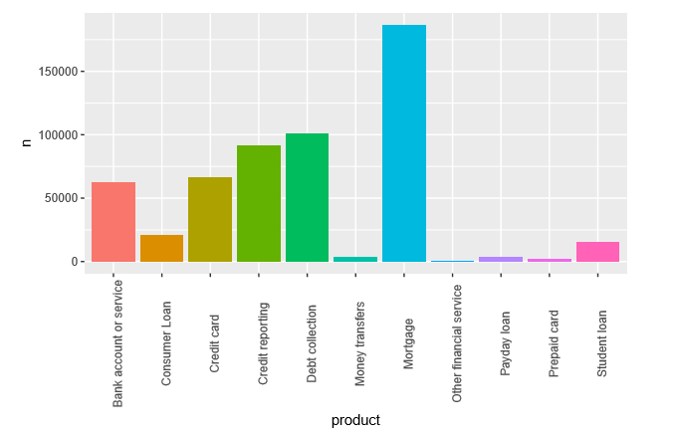
EDA Complaints based on Products
Mortgage, Debt Collection and Credit reporting are the top products.

Slide 7
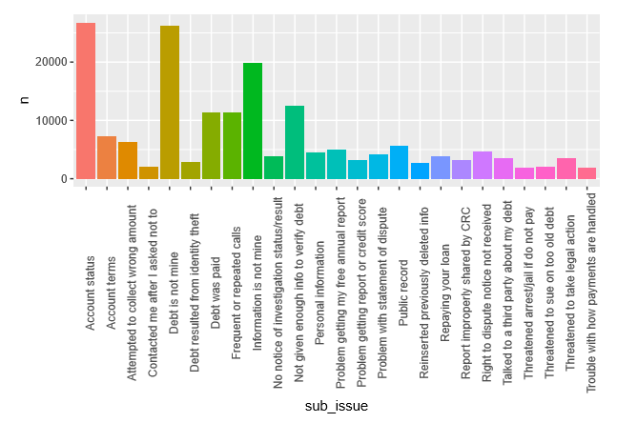
EDA Complaints based on Sub issue
Sub-issues like Account Status and Debt or Information is not mine are top.

Slide 8
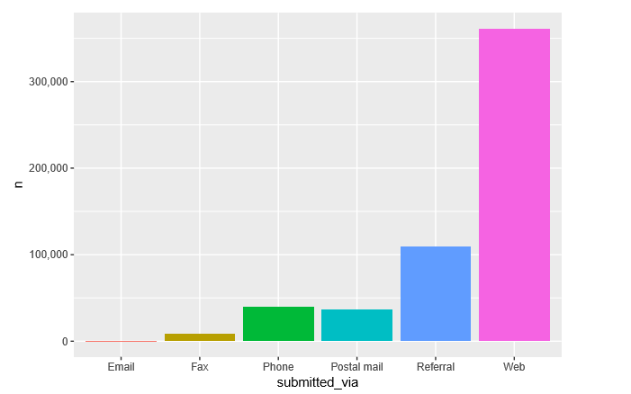
EDA Complaints submission Mode
Consumers mostly submitted their complaints by website.

Slide 9
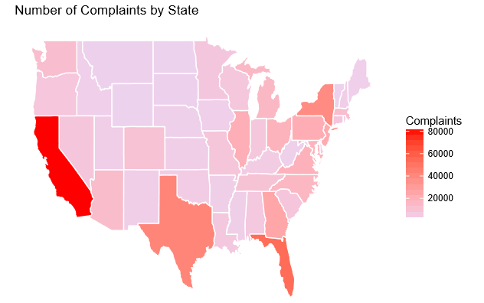
EDA – Geographical Distribution
Most Complaints originated from California and Texas.

Slide 10
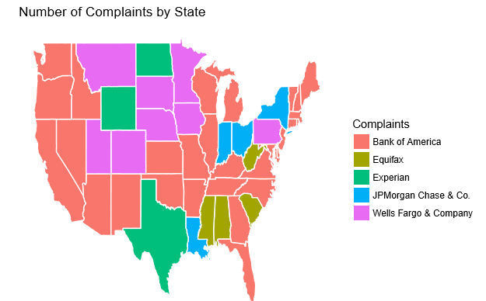
EDA – Geographical Distribution
Complaints distribution by companies

Slide 11
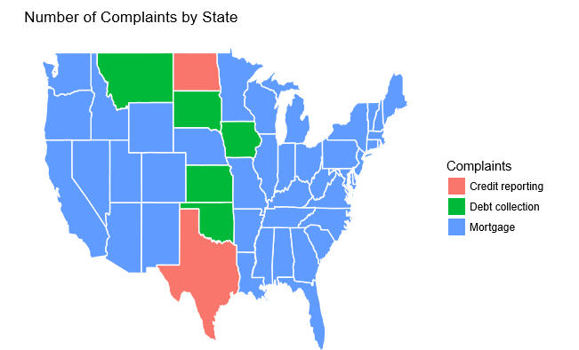
EDA – Geographical Distribution
Complaint distribution based on Products.

Slide 12
Data Analysis
Based on Parameter
Complaints ratio
Response Time
Dispute Rate
Positive and Negative sentiments
Text Mining
Tidytext package
Text2vec package

Slide 13
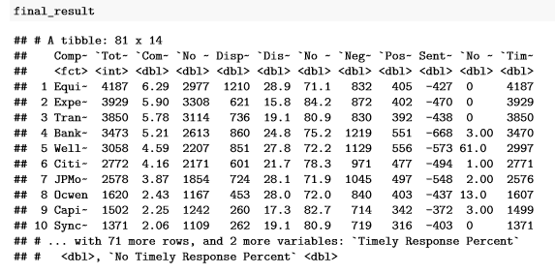

Data Analysis – Based on Parameter
Parameters calculated are -

Slide 14
Text Mining
Tidytext Package
https://www.tidytextmining.com/
Text2vec Package
http://text2vec.org/
Sentiment Analysis, Collocations, Correlations and Topic Modelling

Slide 15
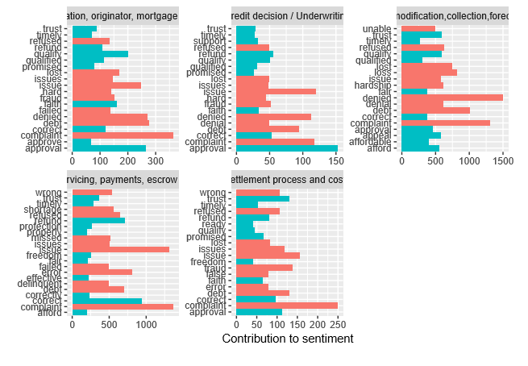
Text Mining – Unigram Analysis
Top positive and negative words respective to each issue for Mortgage Product

Slide 16
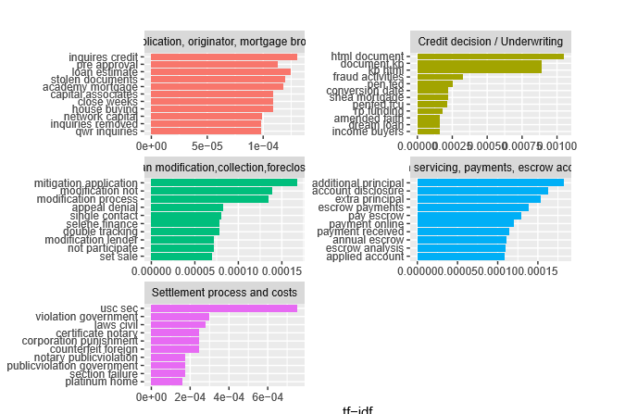
Text Mining – Bigram Analysis
Top bigrams respective to each issue for Mortgage Product

Slide 17
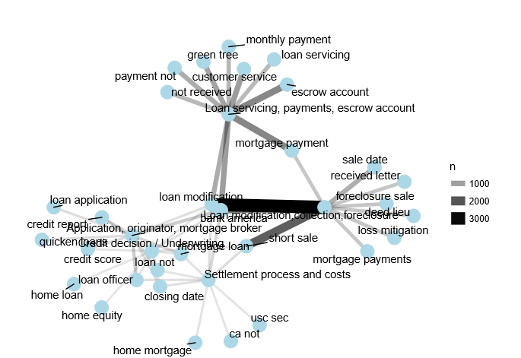
Text Mining – Bigram Connections

Slide 18
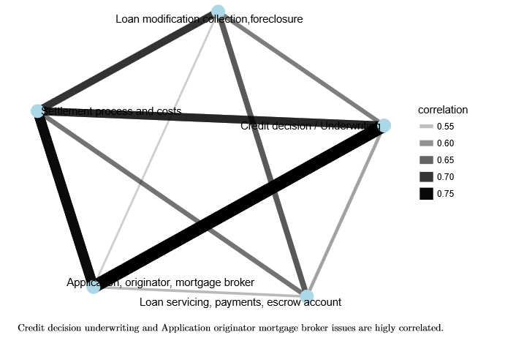
Text Mining - Correlation
Correlation between Issues based on bigram

Slide 19
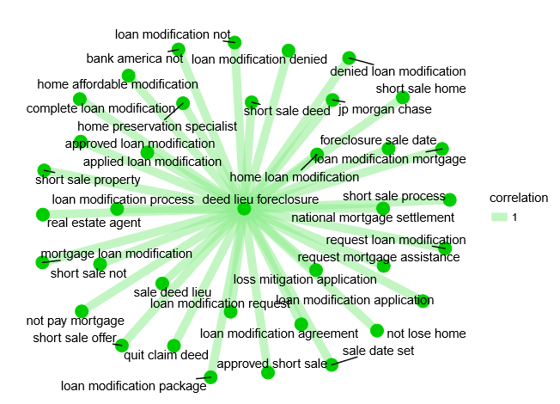
Text Mining – Correlation w.r.t one word – deed lieu foreclosure

Slide 20
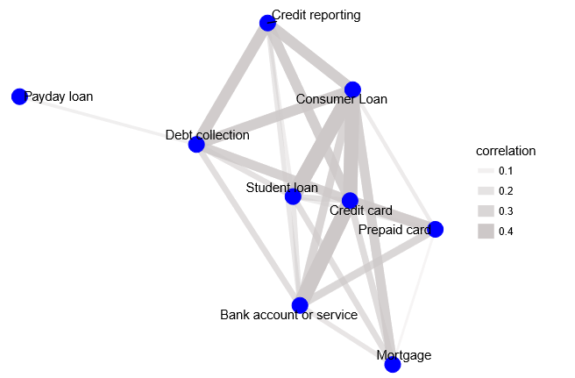
Correlation between Products

Slide 21
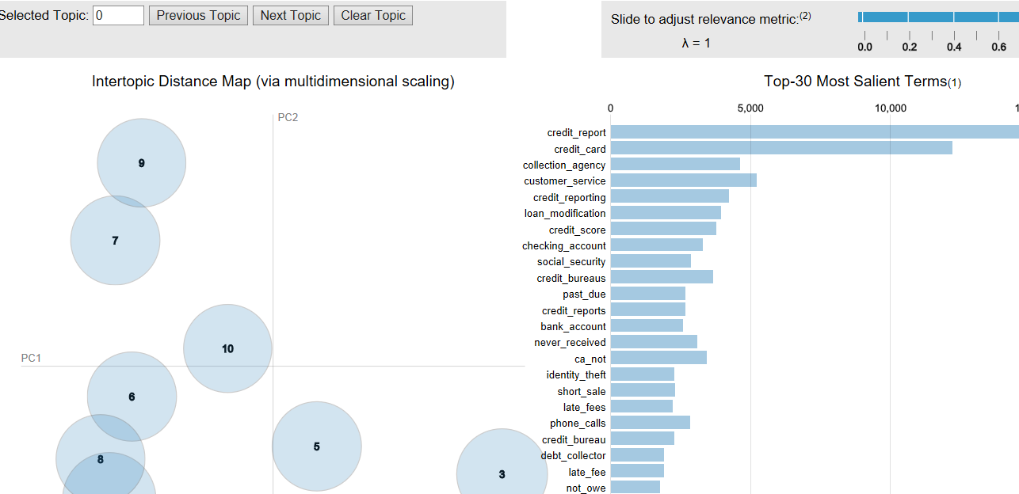
Topic Modelling
Using LDA defining the terms into 10 topics

Slide 22
Future Recommendations
Negation words needs to be separated and then analyzed
To Analyze Stop words or tfidf model is best for the particular dataset.
Stemming needs to be performed to reduce the word list.
To Analyze other algorithms for enhanced results.

